Slide 1
New year in Haiti
By: Mitin p. a. ИУ6-14Б
Supervisor: Lipatova o. v.
Bmstu, 2022

Slide 2

Doubly special holiday

Slide 3
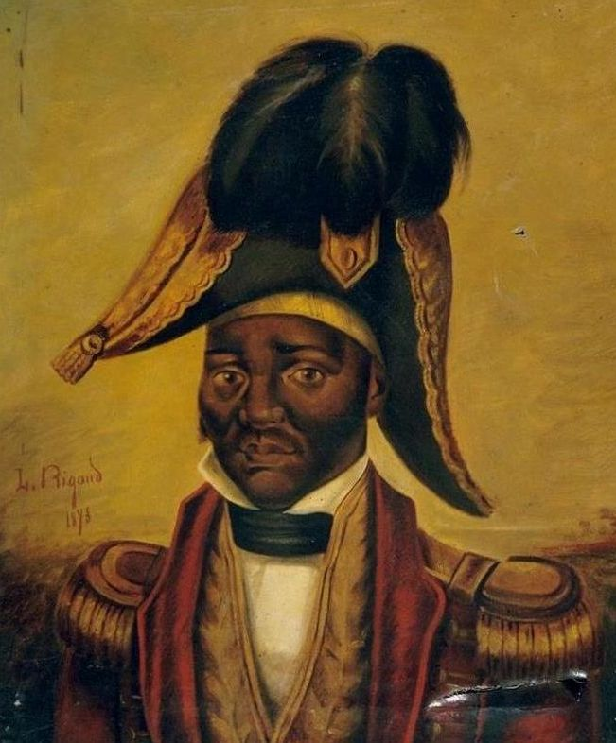
Day of Independence

Slide 4
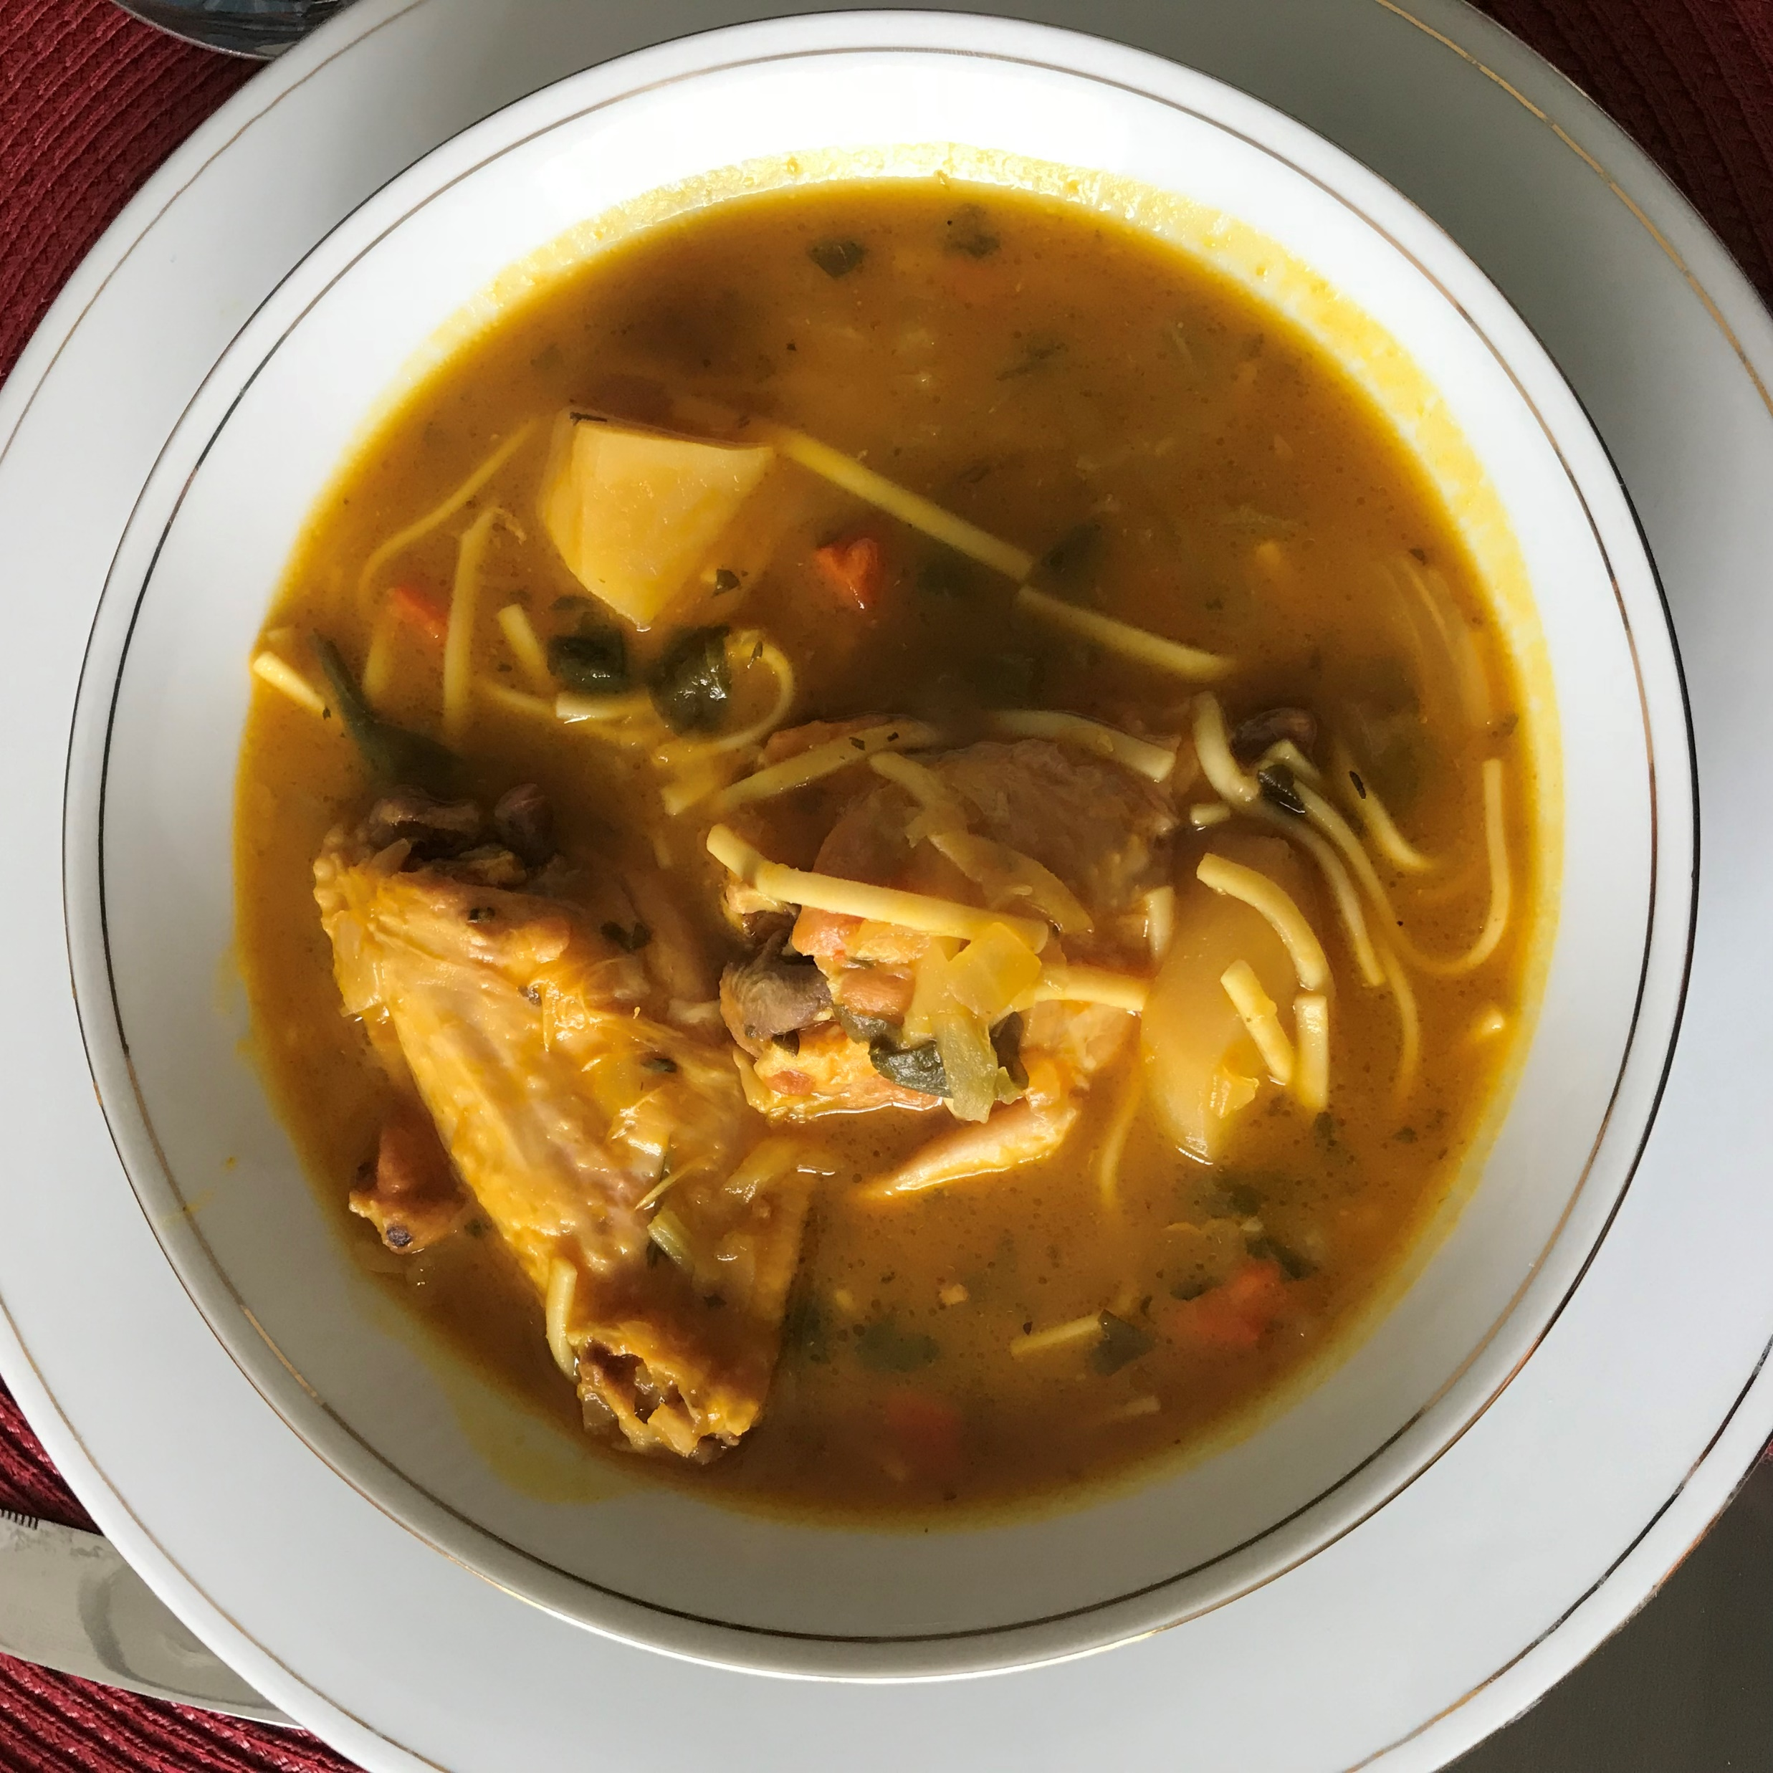
Joumou soup

Slide 5
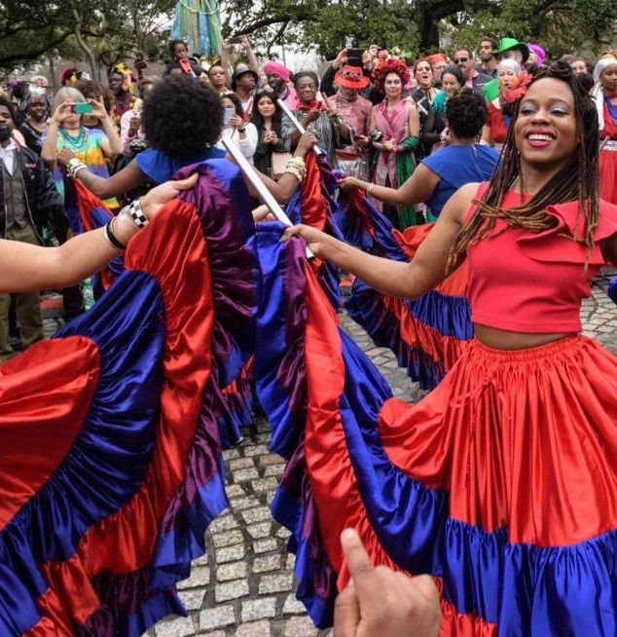
New Year Celebrations

Slide 6
Thank you for your attention!

